Slide 1
Basic Know-how - Concepts
Application Security
a presentation for newcomers
by HNH, PHD, VVT, COH
04.2017

Slide 2
Objectives
Introduce security aspects
Understand various solutions for security issues (only 3-tiers applications are considered)

Slide 3
Contents
Security aspects-
Confidentiality-
  Authentication -
  Authorization-
Application based security -
Limiting access to subset of data -
Services access protection
GUI application access control
Exercises

Slide 4
Security Aspects
Application oriented
Confidentiality: only authorized individuals can access or modify classified data
Infrastructure oriented
Integrity:
  accessed data is guaranteed to be correct at any time
  no intruder can tamper data
Availability: system is available at any time, under any conditions
We focus on the Confidentiality

Slide 5
Confidentiality
Authentication: any individual must prove he is the one he claims to be
login with account and confidential password
check finger prints
check iris...
Authorization: any authenticated individual can only access data or features that he is allowed to
one individual has Roles (Credentials)
one Role determines a list of rights to access data or features

Slide 6
Confidentiality (Cont.)
Audit: a “security administrator” must have access to security information
“audit logs” of unauthorized attempts or critical authorized access
nobody can modify or destroy this information (non-repudiation)
get evidence (proof) that some individual misbehaved with the system
Assurance: gives certitude that the system keeps it security promises
security mechanisms have “no” bugs or security holes
protection mechanisms are always enforced by the system
there is no way to circumvent the protection mechanisms

Slide 7
Authentication
Purpose: be sure about the identity of a user
The identity defines one (or more) unique characteristics of an individual
Several ways (depending on the required security level)
login through account and “secret” password (most often)
login through a magnetic or chip-card (in ATM, shops, companies)
login through voice recognition (at FBI offices)
login through finger prints scan
login through iris analysis (at DoD)
Login through ELCARD
…
The system must store characteristics for each user
We will focus on the account/password login

Slide 8
Authentication (Cont.)
Login through Account and Password
not 100% secure (password is easily “stolen” or “given”)
Precautions
password input must be safe (don’t display it on the screen)
password transmission must be secure (avoid network spying)
empty or too simple password should be forbidden
password should be changed often
password must not be stored “in clear” by the system
password should be encrypted with a one-way algorithm
user should be logged out after some period of inactivity
quit application after 3 failed login attempts
...

Slide 9
Authorization
Purpose: be sure a user only accesses what he is granted
Several ways
protect access to data (essentially for 2-tier applications)
protect access to features (services) accessing data (3-tier)
Precautions
users may be authenticated or “anonymous”
give “roles” to users (role acts almost as a group of users)
grant “rights” to roles (thus, implicitly, to users)
rights tell that some data or some feature are accessible
there must be a “security administrator” who creates accounts and give roles to them
the roles of a user must be stored in the system and must not be modified by anyone but the “security administrator”

Slide 10
Application based security
Use application mechanism (through an application table) to authenticate and authorize users.
create the application DB structure (usual task)
create an USER table that contains account, password, role
create one special DB “super user” that has all access to all tables
create new users by inserting into USER table
each user must login with its USER account/password
the application actually logs in as the “super user”
the application checks the user by selecting from USER table
the application manages all access rights by itself
Notes:
Skip the slide if necessary. Nowadays This solution is rarely used.

Slide 11
APPLICATION based security (Cont.)
Example
a system must handle customer orders
2 kinds of users: sales users, packaging users
create table ORDER (…);
create table USER(ACCOUNT vc2(30), PWD vc2(20), ROLE number);
create user SU; grant all to SU;
insert into USER values(‘JPT’, <pwd1>, 1); -- 1 means PACKAGING
insert into USER values(‘JPO’, <pwd2>, 2); -- 2 means SALES
login: select ROLE into :role from USER where ACCOUNT=? and PWD = ?
create order: if (:role != 2) raise AccessDeniedException, else insert into ORDER values (…)

Slide 12
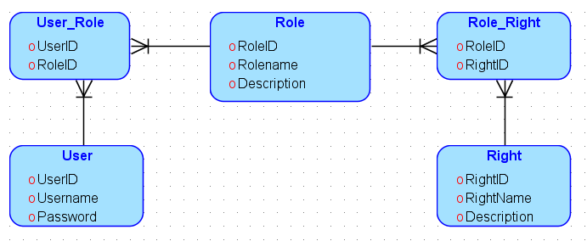
Application based security (Cont.)
Design
Password of an application’s user has to be encrypted before being saved into DB. The encryption must be one way.

Slide 13
Limiting access to subset of data
Why?
Many applications must provide all users with access to all tables, but must limit the rows that one user can access
How?
Adding correct “where clauses” to all select statements
  risk to forget it somewhere
Create “smart” views and deny all rights from normal tables
  create view SALESVIEW as select * from SALES
  where SALESPERSON = :user
  no risk of forgetting
  might need to create very complex views
  requires to pass :user parameter for every queries

Slide 14
Services access protection
Authorize or deny execution of a service method for a user
Application Servers include authorization capabilities, that are more or less complex to use in a system being implemented
Some frameworks (e.g. Spring/NInject) considerably simplify this to merely a matter of configuration (no need to code specific things)

Slide 15
GUI application access control
Client application manages access restriction through GUI widgets access
after login, application is aware of user’s role
depending on user’s role (in addition to business rules), widgets are disabled or hidden
it becomes impossible for a user to call unauthorized actions (i.e. access unauthorized data) from this application
application acts user-friendly since it does not show access to prohibited methods: user can concentrate on his tasks

Slide 16
Exercises
Based on the data model in slide 11, write a function to load security information (e.g Roles, Rights) of the logged in user
To protect services exposed by “business tier” in the PIM tool, each method requires the logged in user to have a list of certain rights as described by the following matrix:
  Design a data model to store such information
  Write a function to protect a service using the data in question (1)
Service name | Engineer | Project Leader | Group Leader
SearchProject | X | X | X
CreateProject |  |  | X
EditProject |  | X | X

